Slide 1
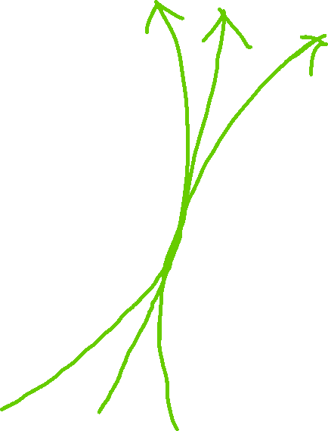
Any path between two points must pass through their midpoint -
with 1 exception we’ll explain later.

Slide 2
Here is an example layout where the dinosaurs are the blue dots.

Slide 3
Generate the Voronoi Diagram using something like Fortune’s Algorithm.
You can use this information to avoid having to process every pair of points.

Slide 4

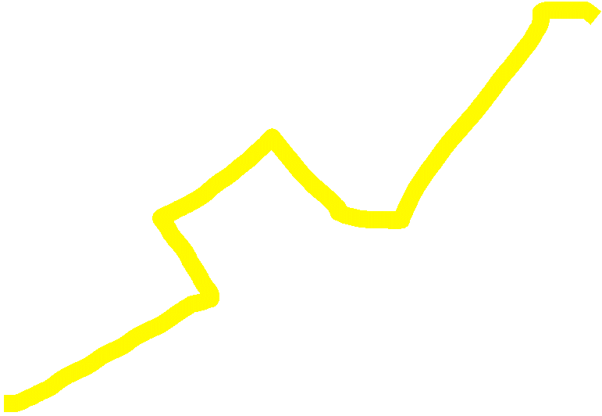
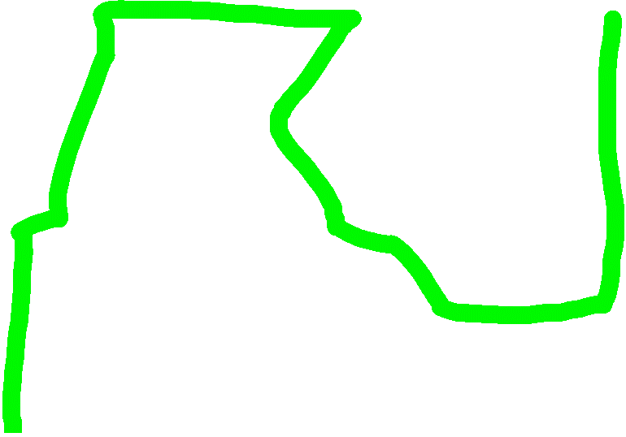
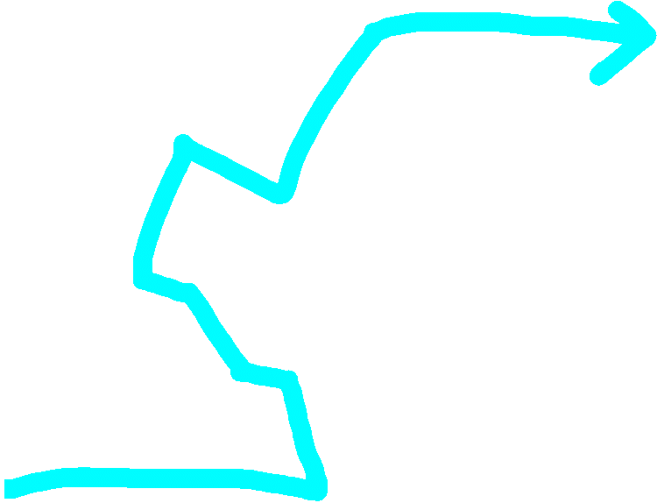




Conceptually, these segments represent paths to the exit.
Notice the paths will usually pass through the midpoint we mentioned earlier...
I’ll explain that more in a bit, but pretend it always does for now

Slide 5
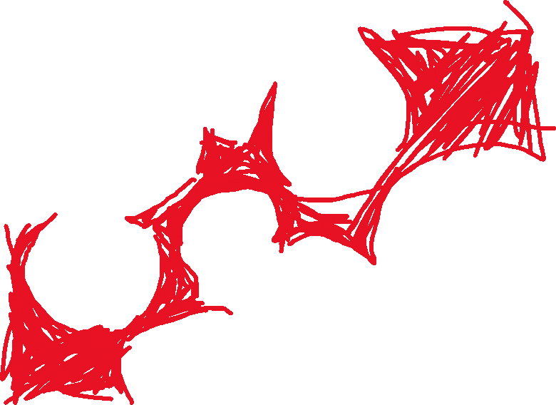
The paths along the segments (red line) are optimal for any equivalent path (the orange regions below) passing between the same sequence of dinosaurs because the path passes through each pair of points optimally.
For example, the smooth green line below is equivalent to the red line of segments for the challenge.

Slide 6
We just need to find the best sequence of points to travel through.
This is the shortest path with some modifications for calculating an edge’s weight.

Slide 7
Note, the only time an optimal path does not pass exactly through a midpoint happens when a third point is closer to that midpoint than the other 2.
This Point is closer to the ‘X’ than the other 2 are

Slide 8




For example, the ‘X’ where the orange lines intersect is where a midpoint is, but the segment that would have passed through that line is ‘pushed back’ to where the green lines intersect.
This is okay because the paths along the Voronoi Diagram are still optimal! So just be sure when you calculate the “weight of a segment” through 2 points, that you use the distance to the segment and not the midpoint!

Slide 9
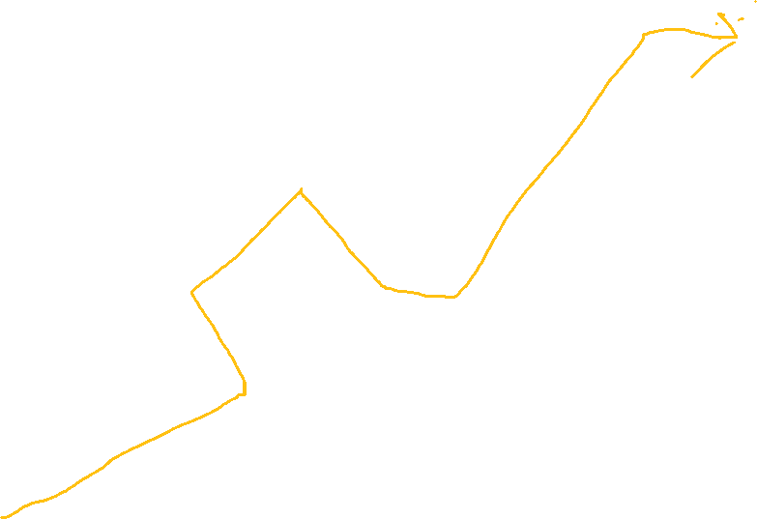
To understand how to handle an edge’s weight, first consider how the result is computed for a given path;
You find the smallest distance between the dinosaurs it passes between.
For example, the result of the green path below is 3.
3

Slide 10
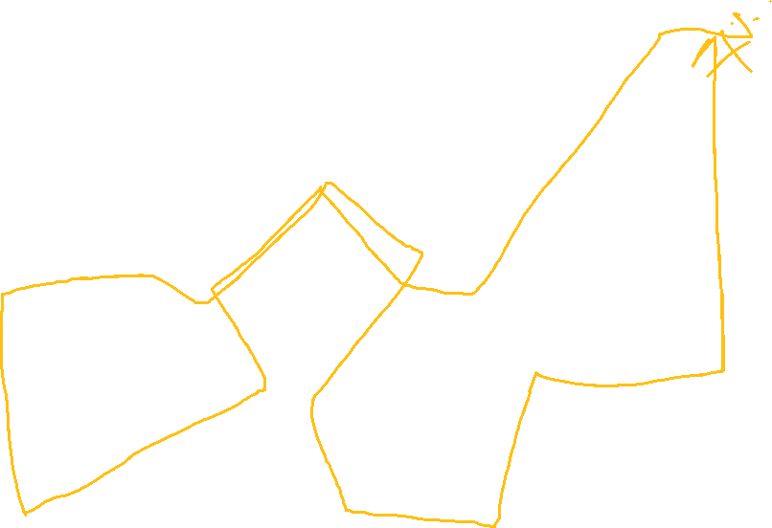
In fact, it doesn’t matter where a path goes as long as new paths have a larger distance than the current minimum.
For example, the red and green path below are equivalent because they both have a minimum distance of 3.
This is why in our shortest path algorithm, the “weight” of a new edge is 0 as long as the distance is larger than the min.
3

Slide 11
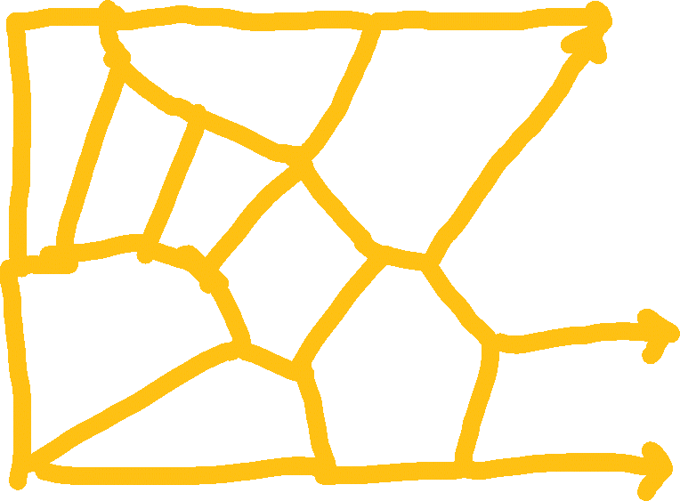
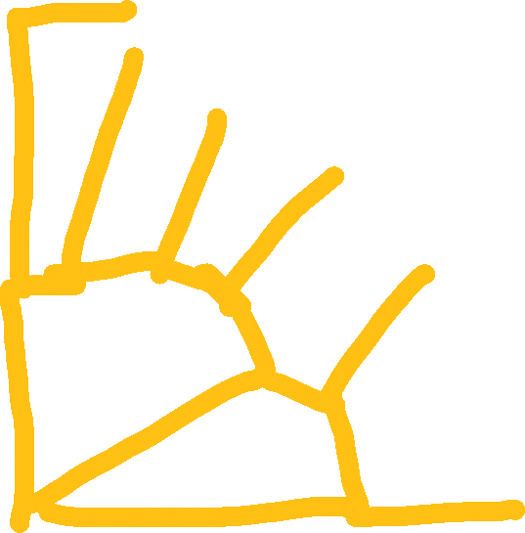
Below is an illustration of how an algorithm similar to Dijkstra’s would progress. In the picture, the orange segments have already solved the best paths up to points A,B,C,D and the green arrows are the paths being considered to points X,Y,Z. The path from Point A to Point X is chosen because the weight of the edge is 0 and the other paths for consideration produce wore paths if taken.
A: Best Path=5
Dist=7
X: Best Path: 5
Dist=4
Y: Best Path: 4
B: Best Path=6
Dist=4
Z: Best Path: 3
C: Best Path=8
D: Best Path=4
Dist=3

